Slide 1
Linear Regression

Slide 2
What will be covered
What’s simple linear regression.
Dataset Exploration: Loading and exploring a sample dataset.
Implementation: using sklearn Library
Visualization : Plotting and interpreting the results.
Evaluation :Evaluating model performance with metrics

Slide 3
Simple linear Regression
Simple linear regression is a technique used to model and analyze the relationship between two variables.
Specifically, it helps us understand how one independent variable, often called the feature, influences a dependent variable, known as the target or outcome.
Think of it as drawing a straight line through a set of data points to predict future values based on that line.
Uses
Prediction Tasks: Forecasting sales based on advertising spend., Estimating house prices based on square footage.
Data Analysis: Understanding relationships between variables., Identifying trends and patterns.

Slide 4
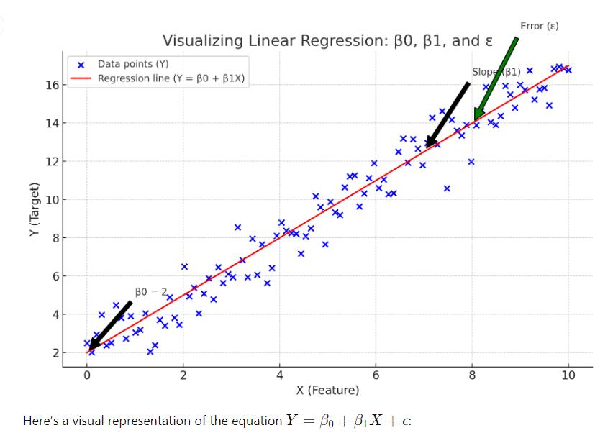
Simple Linear Regression
Y=β0​ + β1​X + ϵ
where
Y: is the dependent variable,
X: is the independent variable, β0​: is the intercept
β1​: is the slope
ϵ: is the error term.

